Slide 1
Emergency or Fast Govt. Payments [DEFI/CBDC]

Slide 2
Enhancing Financial Inclusion and Sustainable Spending
Welcome to the presentation on A groundbreaking app designed to address financial inclusion challenges while promoting sustainable spending.

Slide 3
Financial Inclusion Challenges
Many individuals globally face challenges accessing traditional banking services, leading to financial exclusion.
Limited access to banking services, high transaction costs, and lack of financial resources hinder economic participation.

Slide 4
A Vision for Financial Inclusion
Presented Solution: Our app combines Central Bank Digital Currency (CBDC), smart contracts, and environmental tracking to create an inclusive and sustainable financial ecosystem.
Vision: Empower individuals with financial services, transparent government payments, and encourage eco-friendly spending.

Slide 5
Features
Financial Inclusion: Easy onboarding, low transaction costs, and accessibility for the unbanked.
Smart Contracts for Government Payments: Transparent and automated government payment processes.
Environmental Impact Tracking: Incentivizing sustainable spending through rewards and carbon footprint tracking.
Emergency Relief Distribution: Efficient and transparent distribution of emergency relief funds during crises.

Slide 6
MVP Features
User Onboarding: Simple registration and secure authentication.
Digital Wallet with CBDC Integration: Basic wallet functions for CBDC transactions.
Smart Contracts for Government Payments (Simulated): Simulated smart contracts for transparent government payments.
Environmental Impact Tracking (Basic): Basic features for incentivizing sustainable spending.

Slide 7
MVP Development Pathway
Planning: Finalize MVP features and prioritize based on importance.
Design: Create wireframes and design the UI for simplicity.
Development: Start with user registration, basic wallet functionality, and CBDC transactions.
Testing: Conduct usability testing to ensure a positive user experience.
Feedback Collection: Launch the MVP to gather user feedback and insights.
Refinement: Refine based on feedback and iterate on design and functionality.

Slide 8
Blockchain Infrastructure & Database Architecture
Blockchain Infrastructure:
Implement a decentralized network using Ethereum for transparency and security.
Example: Utilize Ethereum's smart contracts for transparent and secure financial transactions.
Database Architecture:
Choose a scalable database like MongoDB to handle transaction data efficiently.
Example: MongoDB provides flexibility and scalability for handling transaction records.

Slide 9
Cloud Service Integration & Containerization for Scalability
Cloud Service Integration:
Leverage cloud services (e.g., AWS, Azure) for scalability and seamless integration.
Example: Use AWS Lambda for serverless functions to handle specific app functionalities.
Containerization for Scalability:
Implement containerization with Docker for efficient scaling and resource utilization.
Example: Docker allows the app to run consistently across various environments.

Slide 10
Load Balancing & Security Measures
Load Balancing:
Integrate load balancing mechanisms to distribute user requests evenly.
Example: Use Nginx as a load balancer to ensure optimal performance during peak usage.
Security Measures:
Implement robust security protocols, including encryption and secure API communication.
Example: Use SSL/TLS for encrypted communication and OAuth for secure API authentication.

Slide 11
Version Control System & IDE
Version Control System:
Utilize Git for version control to track and manage code changes.
Example: GitHub or GitLab for hosting repositories and collaboration.
Integrated Development Environment (IDE):
Choose a suitable IDE (e.g., Visual Studio Code) for efficient code development.
Example: Visual Studio Code provides extensions for various programming languages.

Slide 12
Containerization Tools & Backend Development Stack
Containerization Tools:
Set up Docker locally to replicate the production environment.
Example: Use Docker Compose to define and manage multi-container Docker applications.
Backend Development Stack:
Install Node.js for backend development, ensuring compatibility with the chosen framework.
Example: Use Express.js for building a robust and scalable Node.js application.

Slide 13
Frontend Development Tools & Database Setup
Frontend Development Tools:
Set up a frontend framework (e.g., React) for building user interfaces.
Example: Use Create React App for a quick and efficient React project setup.
Database Setup:
Install and configure the selected database system locally (e.g., MongoDB).
Example: Set up a local MongoDB instance for testing database interactions.

Slide 14
API Testing Tools & Continuous Integration (CI)
API Testing Tools:
Integrate API testing tools (e.g., Postman) for thorough testing of endpoints.
Example: Use Postman for sending requests, testing responses, and validating APIs.
Continuous Integration (CI):
Implement a CI/CD pipeline (e.g., Jenkins) for automated testing and deployment.
Example: Jenkins can automate the build, test, and deployment processes.

Slide 15
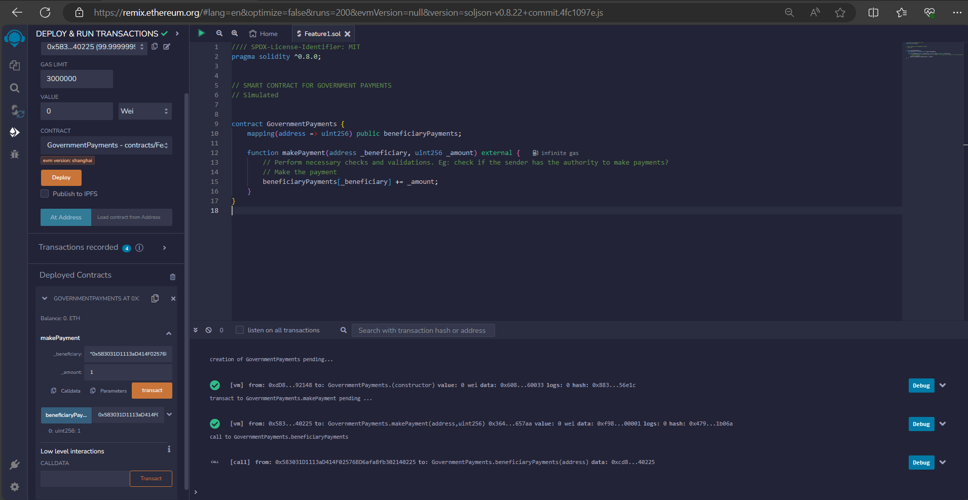
Sample Code : Smart Contract For Government Payments

Slide 16
Sample Code : Smart Contract For Government Payments

Slide 17
Sample Code : Environmental Impact Tracking

